Slide 1
Validation methodologies & performance metrics

Slide 2
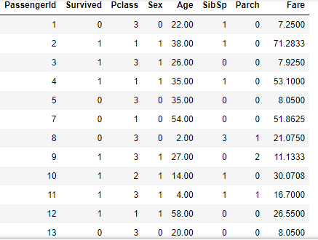

Train-test-methodology: Split the data in train and test sets
Train (75%)
Test (25%)
Features
Labels

Slide 3
Tune hyperparameters
Test accuracy
Data
Machine learning algorithm
Training data
Trained
model
Features
Labels
Labels
Testing data
Data
Predicted
label
Only features!

Slide 4
Machine learning methodologies
The methodology on the previous slide is actually the simplest of all the methodologies used! Here I list all the methodologies I am familiar with (diagrams are shown on the following slides):
“Train-Test” (the one from the previous slide)
“Validation”
“Cross validation”
“Leave-one-out Cross Validation”
Note: We are still only talking about supervised classification!

Slide 5
Split the data in train, validation and test sets:
Train
Test
Validation
Features
Labels

Slide 6
“Validation” methodology
Tune hyperparameters
Validation accuracy
Data
*
Machine learning algorithm
Training data
Trained
model
Features
Labels
Labels
Validation data
Testing data
Test accuracy
*
For the final model you train on both training and validation data!

Slide 7
“Cross Validation” methodology
Tune hyperparameters
Mean of all validation accuracies
Val.
Data
Val.
Machine learning algorithm
Trained
model
Train
Features
Labels
Val.
Labels
Val.
Val.
Testing data
Test accuracy

Slide 8
“Leave-1-out Cross Validation” methodology
Tune hyperparameters
Mean of all validation accuracies
Data
Machine learning algorithm
Trained
model
Train
Features
Labels
Labels
Val.
Special case of cross validation
where each validation-set only
contains one data-point!
Testing data
Test accuracy

Slide 9
About data preparation and feature engineering
Last time we talked about how to prepare your data for machine learning, i.e. stuff like:
Cleaning up data:
- Identify (and remove?) outliers
- Handle rows/columns with NaN-values
Feature engineering:
- Create dummies
- Normalize or scale data
- Representation of text-data (e.g. “Back-of-words”)
But when should you do this?

Slide 10
Tune hyperparameters
Validation accuracy
Data
Machine learning algorithm
Training data
Trained
model
Features
Labels
Labels
Validation data
Testing data
Ideally you should isolate you testing data before you do anything else! That means only doing data cleaning and feature engineering on training and validation data.
Test accuracy

Slide 11
But sometimes that is quite impractical. So for simplicity, we will in some cases do data preparation on all data, and separate the testing data after that!
Tune hyperparameters
Validation accuracy
Data
Machine learning algorithm
Training data
Trained
model
Features
Labels
Labels
Validation data
Testing data
Test accuracy

Slide 12
Perfomance metrics (for supervised classification)

Slide 13
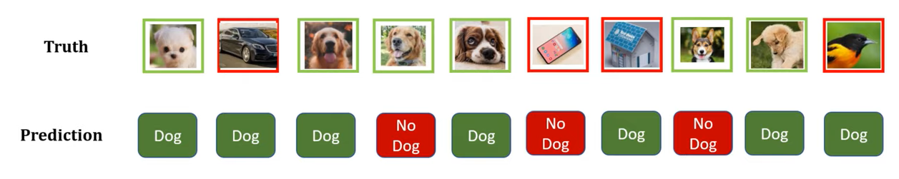
True and false positives and negatives
True positive (TP)
False positive (FP)
True negative (TN)
False Negative (FN)
Picture source: https://www.youtube.com/watch?v=2osIZ-dSPGE

Slide 14
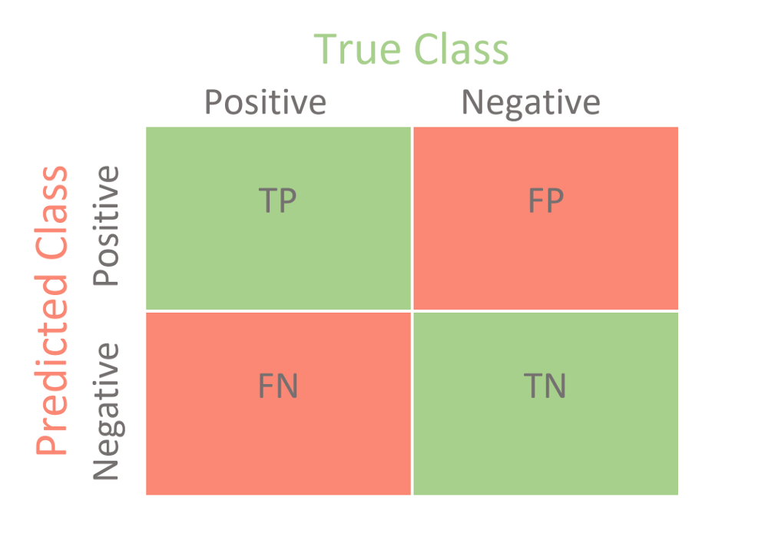
Confusion matrix:
4
3
2
1

Slide 15
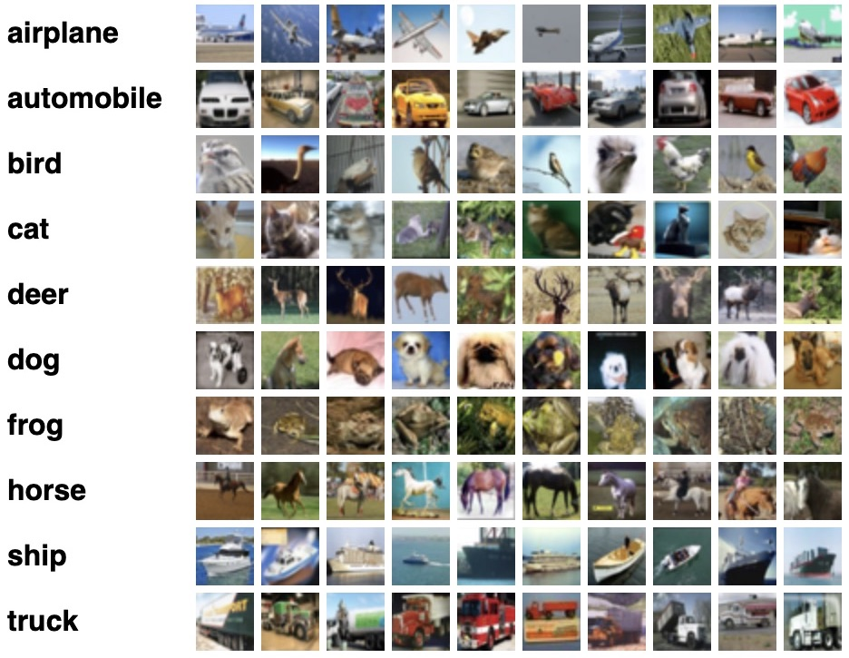
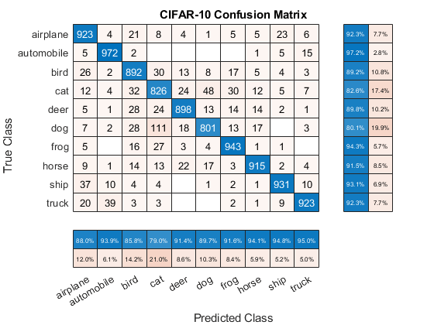
Multi-class confussion matrix

Slide 16
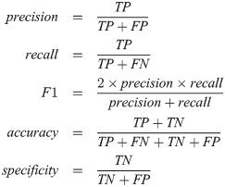
Also called “Positive Predictive Value”
Also called sensitivity
or “True Positive Rate”
Also called “True Negative Rate”

Slide 17
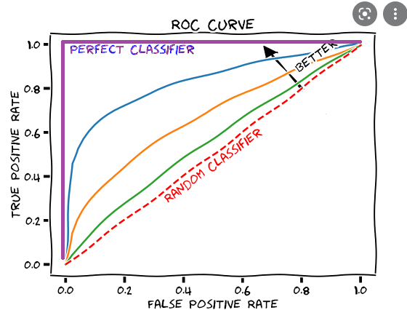
ROC curve Displays the trade-off between high True positive rate and low false positive rate
For the NB classifier you can control where you are on the curve by changing “priors”:
Picture source: https://glassboxmedicine.com/2019/02/23/measuring-performance-auc-auroc/

Slide 18
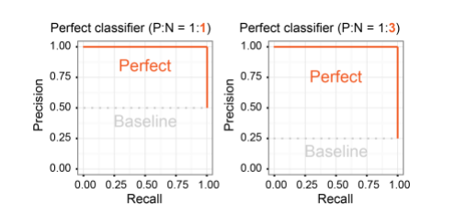
Precision-recall-curve Displays the trade-off between high precision and high recall
Picture source: https://classeval.wordpress.com/introduction/introduction-to-the-precision-recall-plot/

